Slide 1
IMPACT OF CLIMATE CHANGE (Oceanic warming and acidification) on marine Organisms
Group 15

Slide 2
Climate change On Marine Environment
Climate change with regards to the marine environment, connotates the changes in abiotic factors such as: sea levels, temperature, Ocean currents and Ocean acidification, affecting the livelihood of organisms in the marine ecosystem.

Slide 3
OCEAN WARMING
Ocean warming refers to the increase in temperature of the Earth's oceans over time, primarily due to human activities such as the burning of fossil fuels and deforestation.

Slide 4
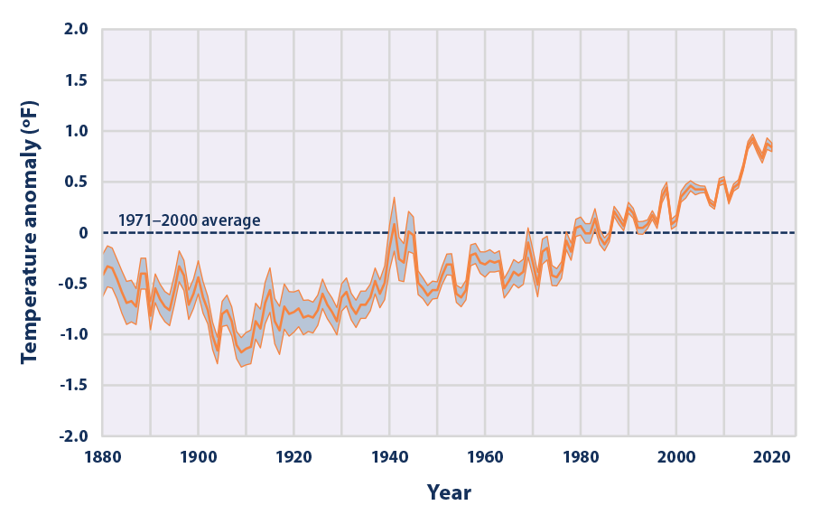
Fig 1.:Average Global Sea Surface Temperature, 1880–2020 (NOAA, 2021).

Slide 5
Impact on marine organism
-Bleaching of coral reefs
-Distribution shifts
-Disruption of reproduction and breeding
-Reduced oxygen availability leading to suffocation
-Change in migration patterns.

Slide 6
Ocean acidification
IT'S Impact on marine organisms

Slide 7
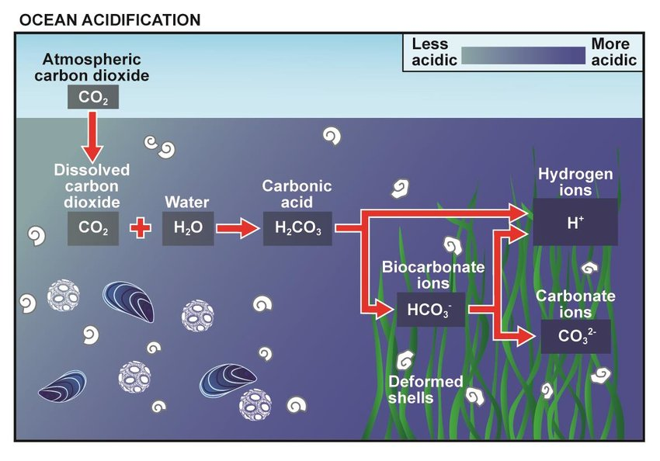

Slide 8
DEFINITION
Oceanic acidification is the process by which the pH of seawater becomes more acidic due to the absorption of carbon dioxide from the atmosphere.

Slide 9
OCEAN ACIDIFICATION CONT'D
The ocean is the largest natural reservoir of dissolved carbon and holds an immense buffering capacity for changes in atmospheric CO₂ concentrations.
The rapid increase of atmospheric CO₂ since the industrial revolution has caused oceans and seas to absorb increasingly greater amounts of CO₂.
This process disturbs the pre-existing chemical equilibrium of the sea, resulting in seas changing their chemical state and altering the ocean pH, becoming more acidic(Williamson P, et al., 2017).

Slide 10
IMPACT ON MARINE ORGANISMS
Disruption of calcium carbonate formation
-Alteration of fish behavior
-Disruption of marine food webs
-Declining shellfish population
-Shifts in marine biodiversity

Slide 11
MITIGATING STRATEGIES to CLIMAtic changes
Reducing Greenhouse Gas Emissions
Sustainable fishing practices
Blue carbon initiatives

Slide 12
CONCLUSION
Oceanic climate change poses significant threats to marine organisms and ecosystems.
By taking proactive measures and collective action, we can safeguard the health of our oceans and the life they sustain.

Slide 13
REFERENCES
NOAA (National Oceanic and Atmospheric Administration). 2021. Extended reconstructed sea surface temperature (ERSST.v5). National Centers for Environmental Information. Accessed February 2021.
Williamson P, Carol M.T, Silvana, NR.2017.Future of the sea: Ocean acidification

Slide 14
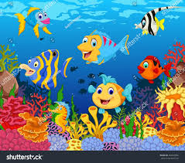
THANKYOU !!!!!!

